Slide 1
CLOUD DATABASES

Slide 2
What is the purpose of Cloud?
Cloud computing is the on-demand delivery of IT resources over the Internet with pay-as-you-go pricing.
Instead of buying, owning, and maintaining physical storage devices – we can use on the go

Slide 3
How Cloud Database Works?
A cloud database is a database that typically runs on a cloud computing platform, access to it is provided as a service such as Amazon EC2 and Rack space.
The cloud database was conceived for the purpose of online data
management by using a variety of distributed servers .

Slide 4
How to run Cloud Database?
1) Virtual machine image
2) Database-as-a-service (DBaaS)

Slide 5
What is Virtual Machine Image?
Cloud platforms allow users to purchase virtual-machine instances for a limited time, and one can run a database on such virtual machines.
Users can either upload their own machine image with a database installed on it, or use ready-made machine images that already include an optimized installation of a database

Slide 6
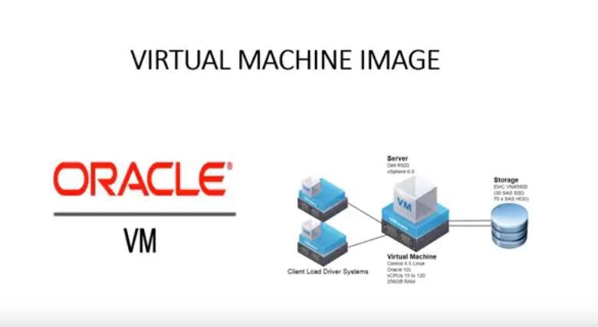

Slide 7
DBaaS
With a database as a service model, application owners do not have to install and maintain the database themselves.
Instead, the database service provider takes responsibility for installing and maintaining the database, and application owners are charged according to their usage of the service.

Slide 8
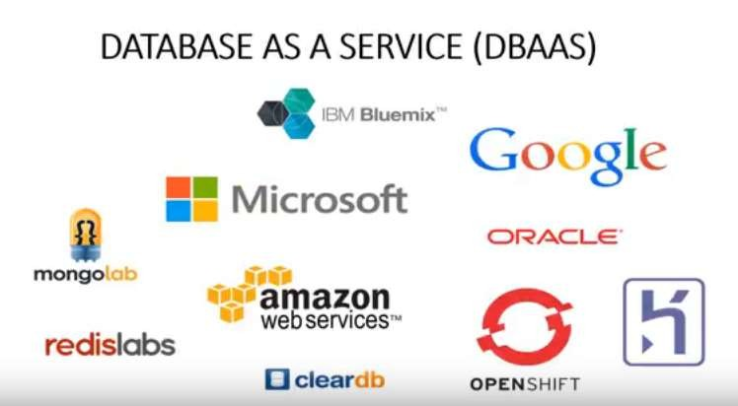

Slide 9
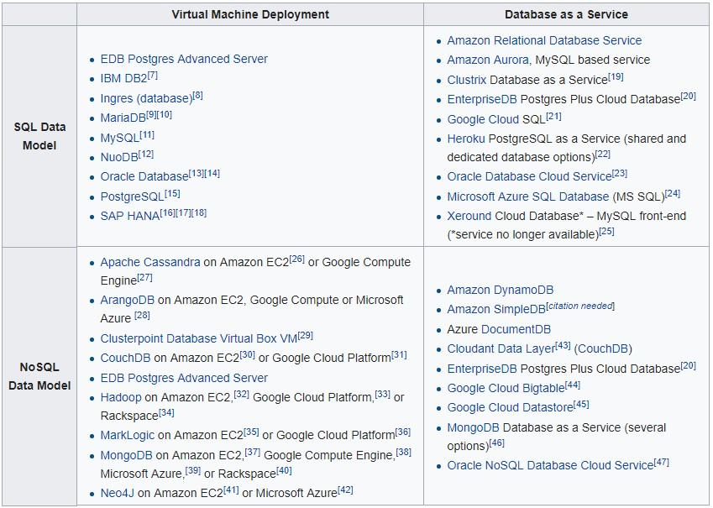

Slide 10
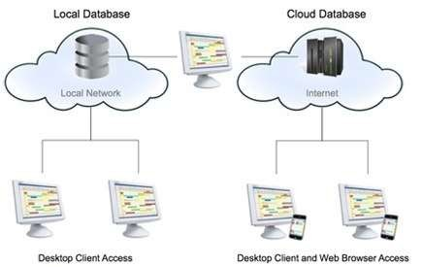

Slide 11
Advantages of Cloud Database
The cloud database system makes information sharing simple and convenient.
Easy access to files and data is what a cloud database actually emphasizes. If freak accidents happen, there is no reason for you to worry since all pieces of information are safely kept.
A cloud database is far cheaper than that of maintaining an actual server, wherein a lot of other applications are necessary.
Being a virtual data storage location, you get every single opportunity of manipulating data wherever you may be.

Slide 12
Security Issues
Ransomware

